Slide 1
Senior Project
Team B
Mario Gonzalez
Rob Decker
Joshua Romanelli
Mamie Dent

Slide 2
Project Description
Create an E-commerce site for Williams Specialty Company, to providing outreach services, displaying the companies catalog, and taking customer orders through a web portal.

Slide 3
Project Scope
System Description
To provide a web site for clients to provide their order information as well as to provide the entire company catalog.
Major Software Functions
Creation, modification, storage, and retrieval of:
  Order request information
  Catalog information
  Purchase order information
  User access information
Allowing the client to enter an order request into the database
Allowing the client to retrieve order request information
Allowing the client to update their personal and billing information
Database Description
MS Access to store order, catalog, client, and payment tables.
Design Constraints and Limitations
Time, distance between programmers, and relative inexperience.

Slide 4
Project Requirements
  Requirement 1: Create several tables:
The Carts table
The Catalog table
The Clients table
The Orders table
The Payments table
The Users table

Slide 5
Project Requirements
Requirement 2: Create a web-site for customers to view and make a purchase if they desire – you must be logged in to make a purchase
The site will display several web-pages:
  default.aspx
  login.aspx
  catalog.aspx
  itemdetials.aspx
  cart.aspx
  order.aspx
  orderdetails.aspx
  account.aspx

Slide 6
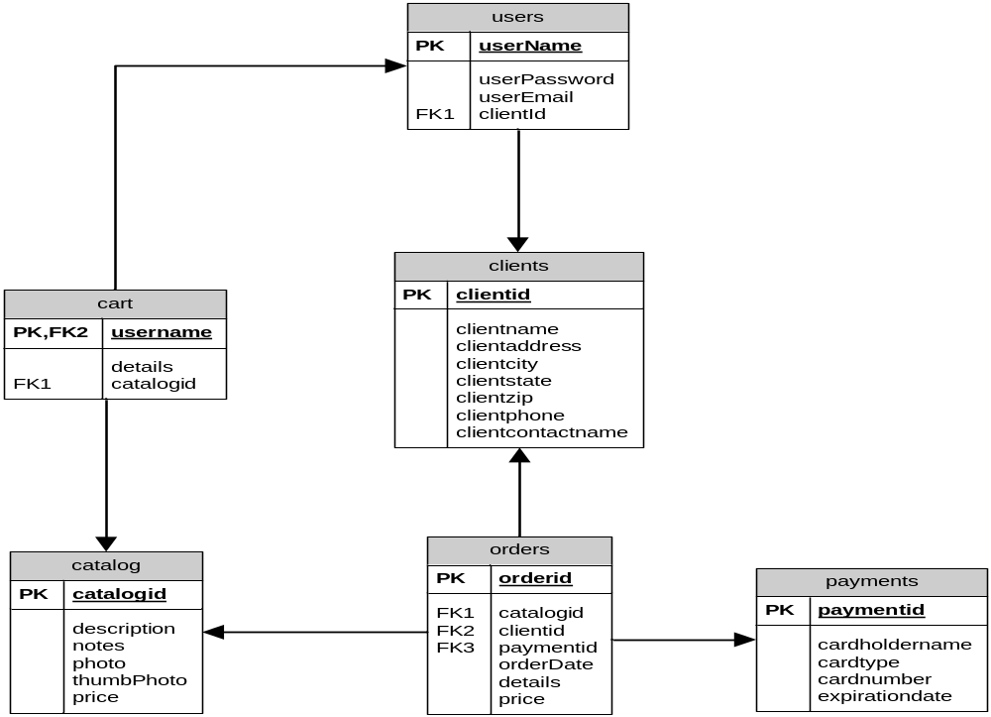
Design Overview: ERD Diagram

Slide 7
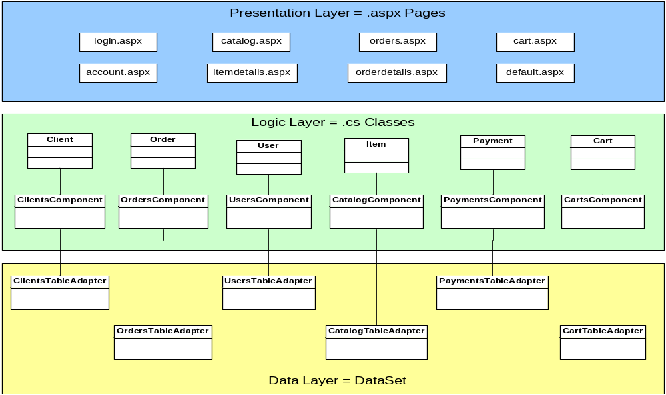
Design Overview: System Diagram

Slide 8
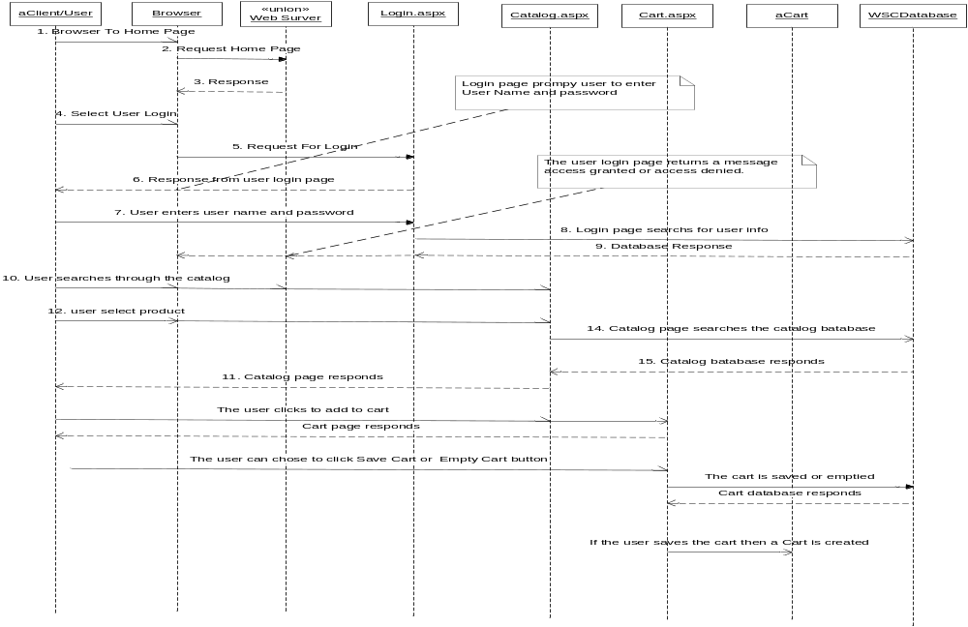
Design Overview: Sequence Diagram

Slide 9
Construction Overview: Development Tools Used
Microsoft Visual Web Developer 2005 Express Edition
Microsoft Access

Slide 10
Test Results
  Unit Test Case Results
Default.aspx Page
Catalog link on this page is working successfully
Login.aspx Page
Successful login – will display a welcome message in the upper right hand corner of the screen and the login link will turn into a logout link, now the customer will be able to make purchases, also the user name text box and the password textbox will disappear
Unsuccessful login – will display an error message stating “invalid user name/password”, and you can log in again using the user name text box and the password textbox
Logout Link – is successfully working – it logs the customer out

Slide 11
Test Results
Catalog.aspx Page
This page displays the merchandise that WSC sells. Baseball Jersey link – is successfully working
Thanks Plaque link – is successfully working
Baseball Trophy link – is successfully working
Itemdetails.aspx Page
The add to cart button is successfully working on each page

Slide 12
Test Results
Cart.aspx Page
There are 3 buttons also on this page and they are listed below
Order Now button – working successfully - will begin the ordering process transferring you to the ordering page
Save Cart button – working successfully – will save the selected item, price, and special instruction in the shopping cart
Empty Cart button – working successfully – will empty the shopping cart

